Slide 1
Global History
A Primer

Slide 2
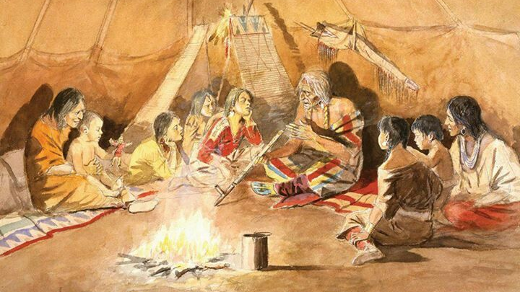
Notes:
Historians are story-tellers
Social function of the historian
Pass on knowledge, real and mythical
Stories grounded in truths or symbolically significant myths
Instill and reinforce collective identities
History v fiction
Stories based on empirical record
Problem 1- incomplete, systematically skewed
Reinforce social norms
Problem 2- Selection bias- what is historically important

Slide 3
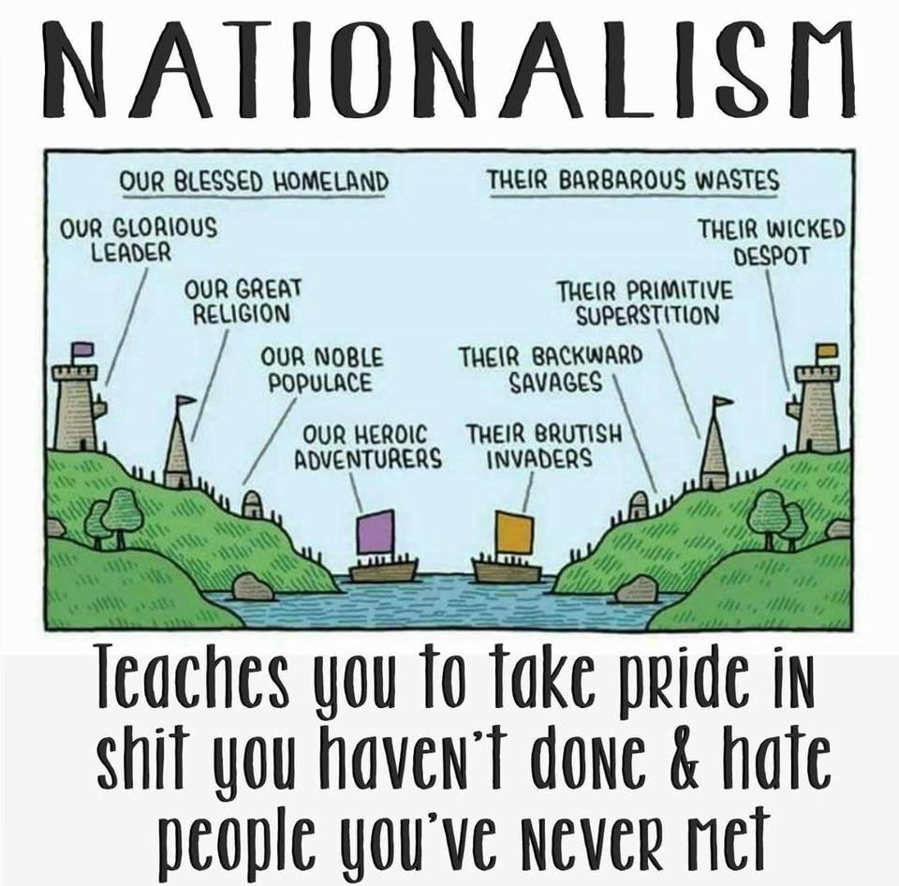
In-Group/Out-Group Stories
Notes:
1) Most enduring story
2) Modern period- nationalism
3) Even other forms of othering usually rest on nationalist metaphors

Slide 4
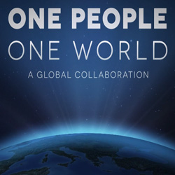
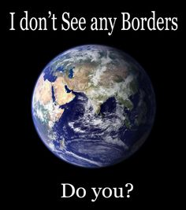
World History: Origins and Goals
Tell the story of one interconnected human civilization, with one past and one future
Arose in the U.S. out of 1960s-1980s academic “global turn”:
World-systems theory
Post-colonial and subaltern thought
Material foundations:
Increasing economic interdependence (globalization)
Space-time compression
“Unipolar Moment” in international relations
Ideology of Global History: Educate the Global Publics to Address Global Problems Requiring Global Solutions

Slide 5
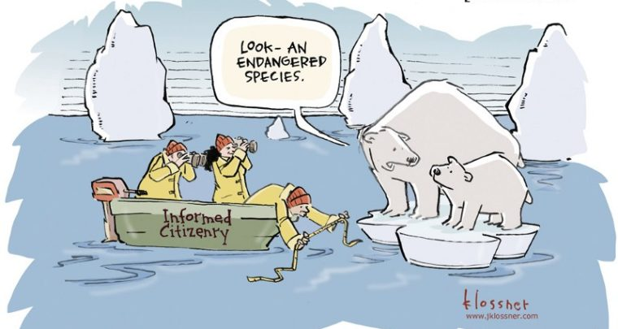
Global Climate Change

Slide 6
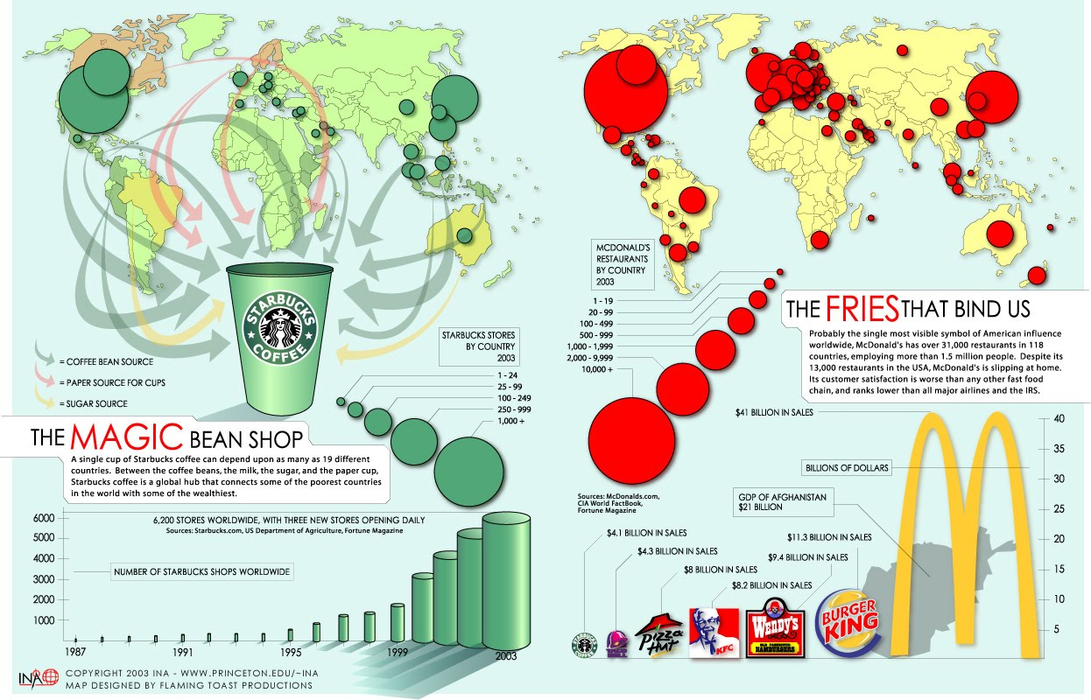
Globalization of Production and Circulation

Slide 7
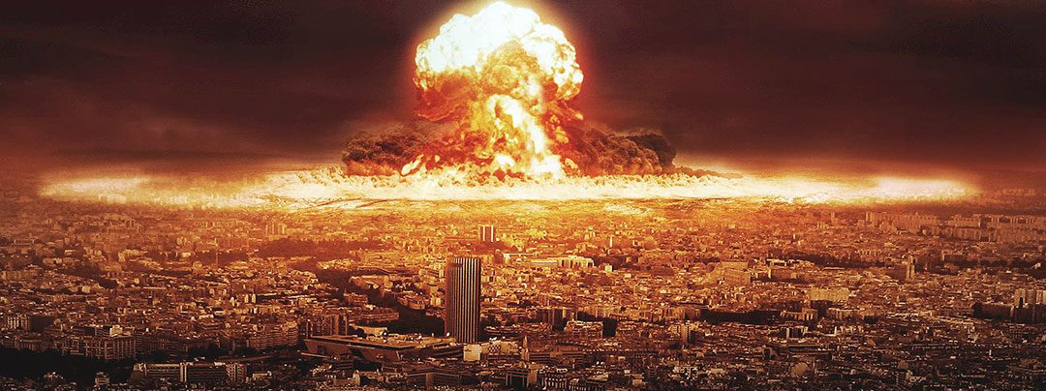
Threat of Total Annihilation

Slide 8
Terminology
World History: History of all parts of the world; terminologically, theoretically, and methodologically vague
Comparative International History: Discrete societies (nation-states) are the analytical unit; comparisons illuminate transhistorical processes
Global History: Unit is the World-System; theory and method is international, transnational, supranational
Notes:
International- think interpersonal. International still reifies the nation-state, and analytically assumes it acts a unified body, then proceeds to focus analytical attention on the dynamics of the way those entities interact with one another.
Transnational- focuses analytical attention on processes that cut across national boundaries.
Supranational- focuses analytical attention on processes that transcend and supersede nation-states, such as multilateral institutions. Just as civil society organizations are thought to be subsumed within a rule-based order mediated by the nation-states, supranational organizations are thought to transcend nation-states, creating dynamics that differ from the lawlessness of an “international” system.

Slide 9
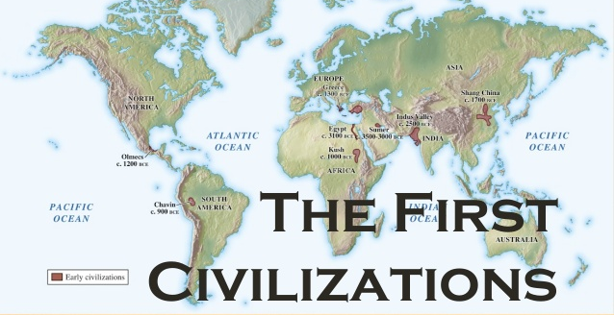

Slide 10
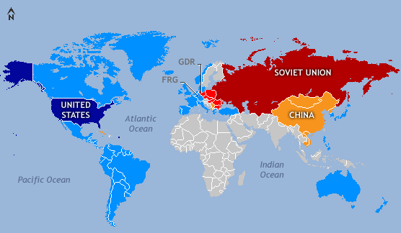
The Cold War and Western Civ
Capitalist Bloc/Socialist Bloc = East/West = Orient/Occident
Western Civ- universal values of freedom, democracy, and private property emanated outward from Europe
Interdisciplinary “modernization theory” viewed nation-states as discrete entities moving independently along a universal historical trajectory

Slide 11
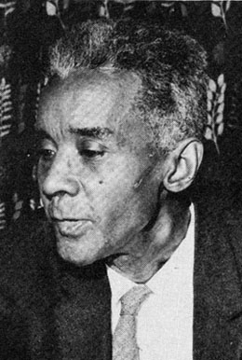
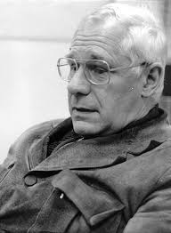
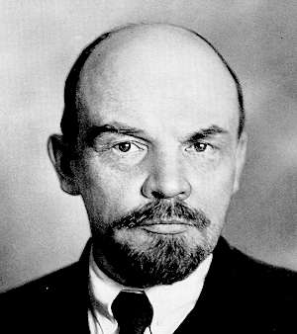
History of World-Systemic Thought in the U.S.
Scholarly influence of Lenin’s “Imperialism”
1940s/1950s anthropology and sociology on the Third World
Caribbean scholars: CLR James Black Jacobins (1938); Eric Williams Capitalism and Slavery (1944); Oliver C. Cox
Latin American Dependency Theory: Metropolis-Satellite challenges Modernization

Slide 12
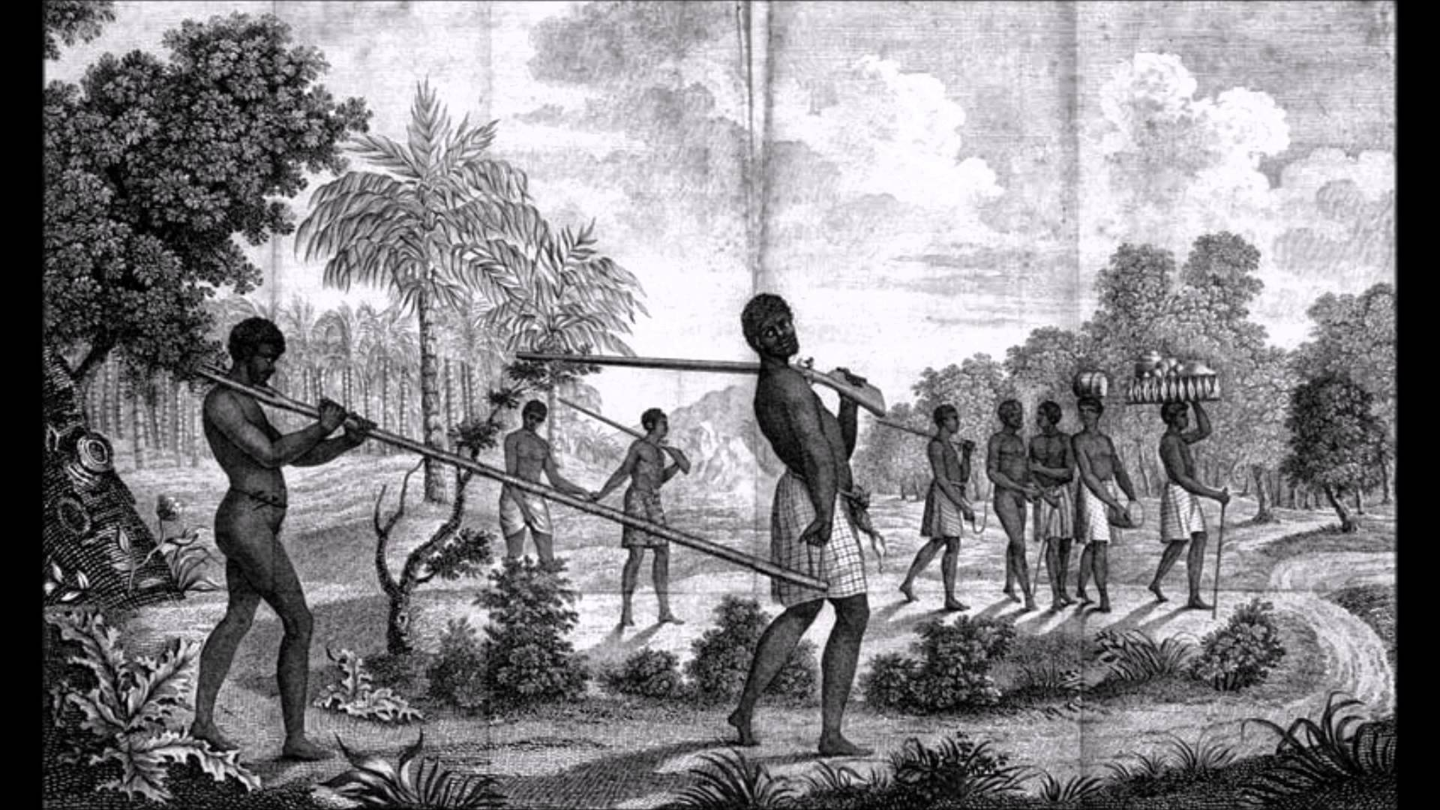
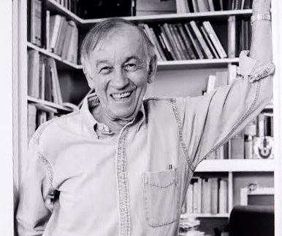
Sidney Mintz Sweetness and Power
Marxist anthropologist with decades of field work in the Caribbean
Influenced by Caribbean and Latin American world-system approaches
As a primary source: moment in evolution of the theoretical scaffolding of world history
As a secondary source: commodity history of sugar to explain European/Caribbean metropolis-satellite relation

Slide 13
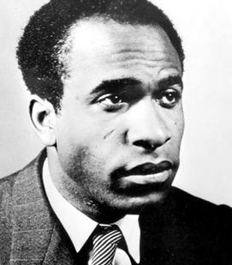
Frantz Fanon
Raised in French Caribbean colony Martinique
Western education, in psychology and literature
Black Skin, White Masks (1952) and The Wretched of the Earth (1961) pioneer works of “post-colonial” or “subaltern” studies
Emphasizes violence glossed over or explicitly rationalized by Western Civ narrative
Or even the cultural violence of the narrative itself

Slide 14
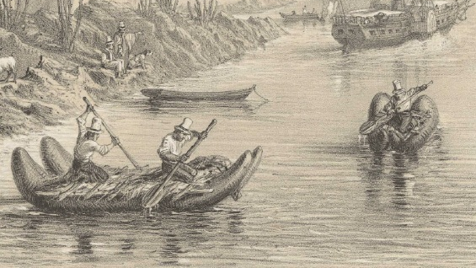
Theory of global history: Uneven and Combined Development

Slide 15
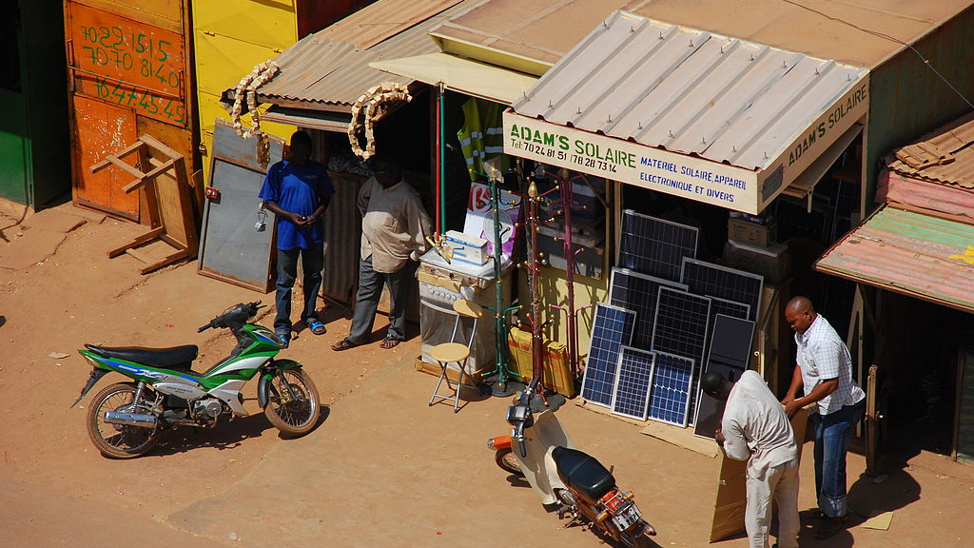

Slide 16
Uneven and Combined Development
Human civilizations develop according to similar patterns, though unevenly, mitigated by contingencies, and mediated by local particularities
Interchange of ideas and material goods along transnational networks alters historical trajectories
Social structures, ideas, culture, and political and economic institutions “skip stages” or take “hybrid forms”

Slide 17
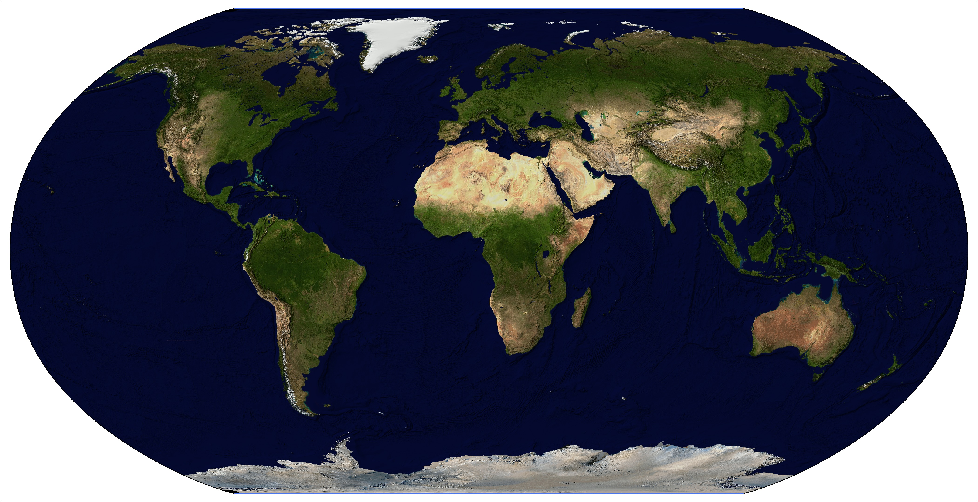
The World at the Dawn of the Modern World System

Slide 18
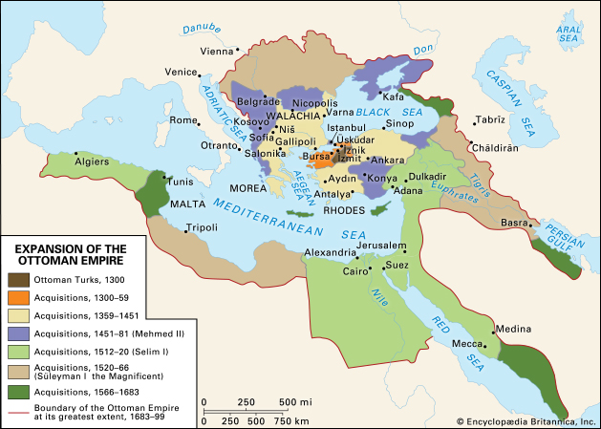


Slide 19
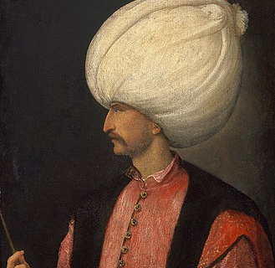
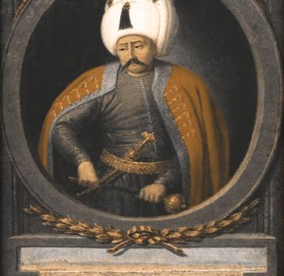
Ottoman Sultans
Selim I (1512-1520): Expanded empire by seventy percent, conquering much of the territory controlled by the Safavid Persians and Northern Africa
Suleiman I (the Magnificent) (1520-1566): Extended into Southeastern Europe and Northern Africa, gaining control of most of the Mediterranean

Slide 20
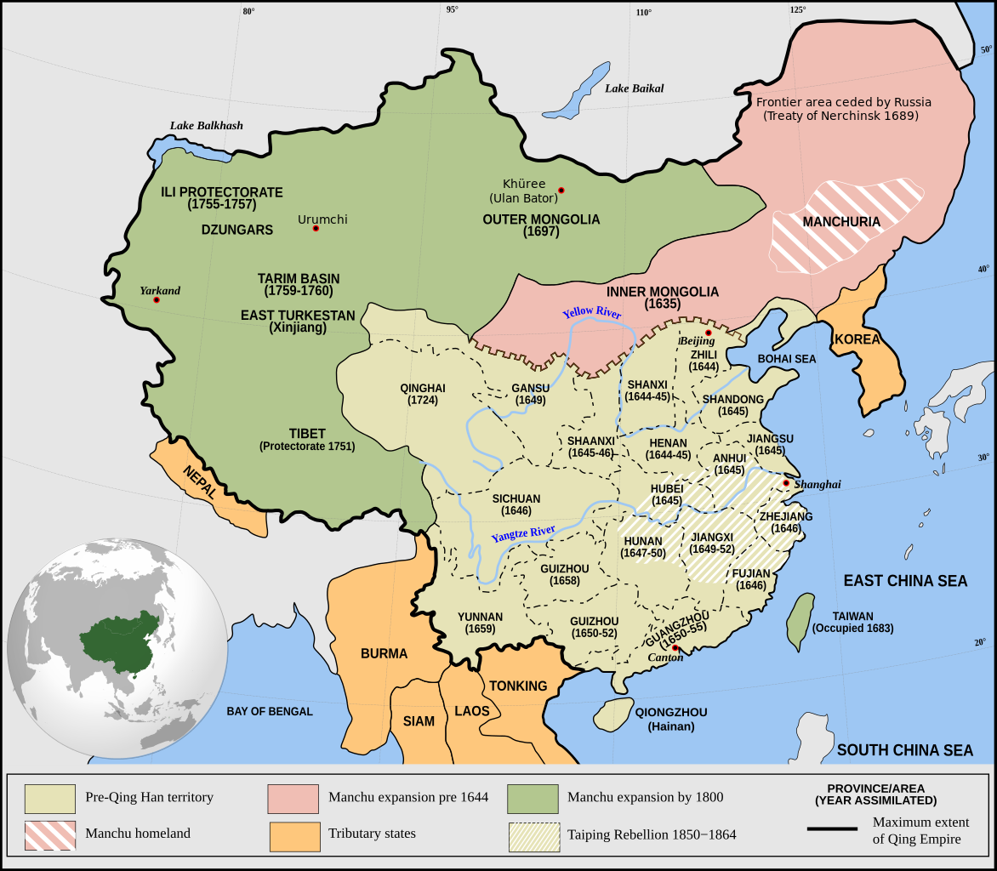

Slide 21
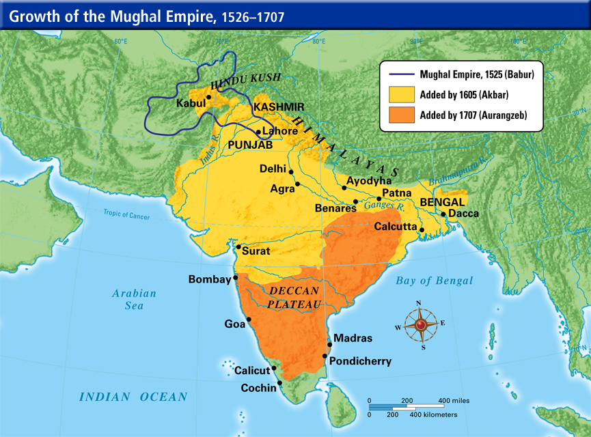

Slide 22
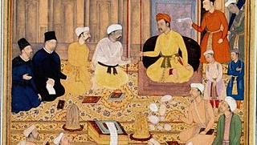
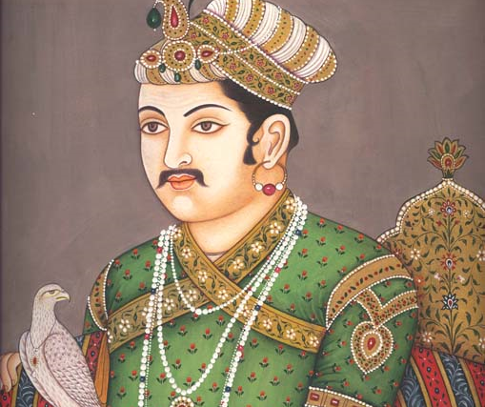
Akbar the Great
Expanded the Mughal Empire
Assimilated people in conquered territories through diplomatic marriages and earning allegiance of local leaders
Created centralized, administratively modern empire
Practiced religious tolerance in multi-ethnic empire

Slide 23
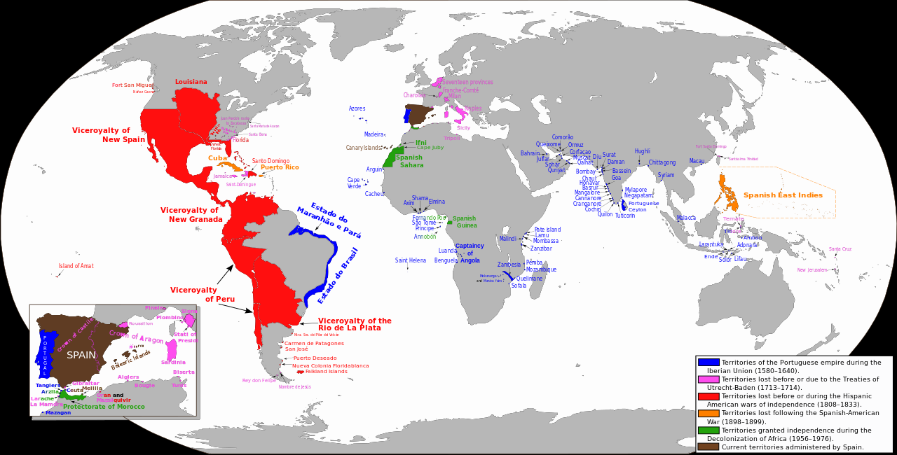

Slide 24
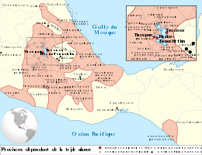
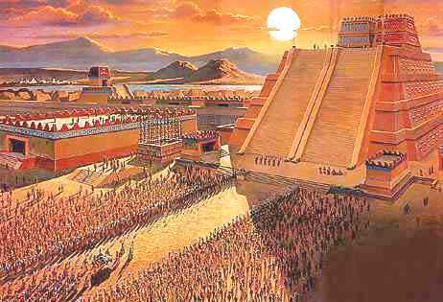
Aztecs

Slide 25
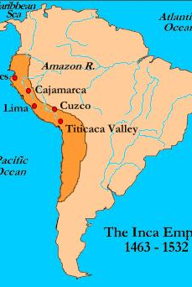
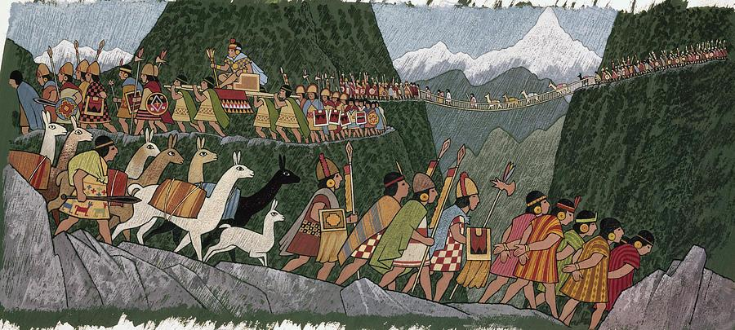
Incas

Slide 26
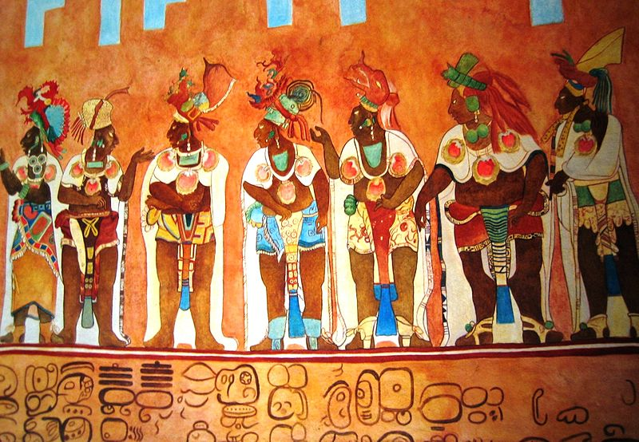
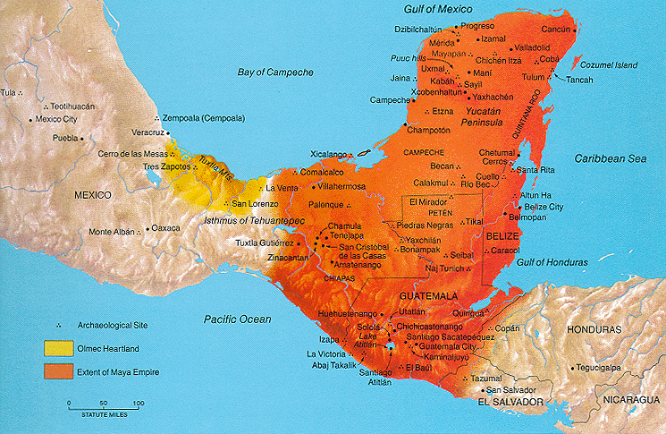
Mayans

Slide 27
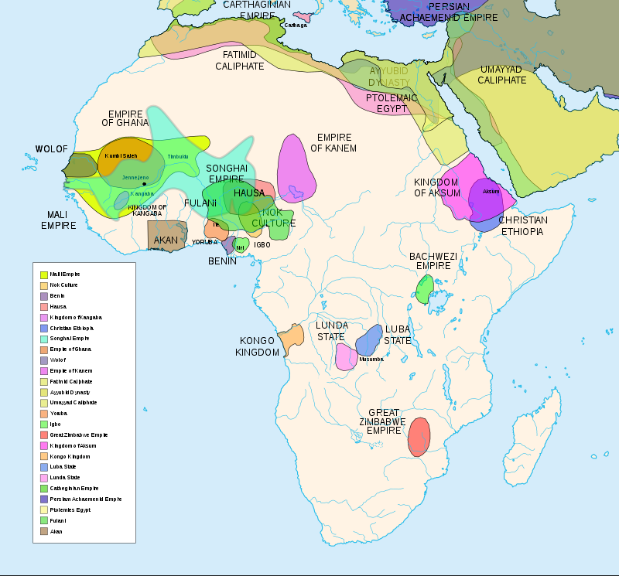
Precolonial Africa

